Slide 1

BASIC DETAILS OF THE TEAM AND PROBLEM STATEMENT
Organization Name : MINISTRY OF HOME AFFAIRS
PS Code : SIH1308
Problem Statement Title : THREAT ZONE OF AN EXPLOSION PARTICULARLY IN OIL AND GAS HANDLING INDUSTRIES OR REFINERIES
Team Name : DYNAMIC DRAGONS13
Team Leader Name : BOOBATHI RAJA K M
Institute Code (AISHE) : C-37065
Theme Name : DISASTER MANAGEMENT

Slide 2
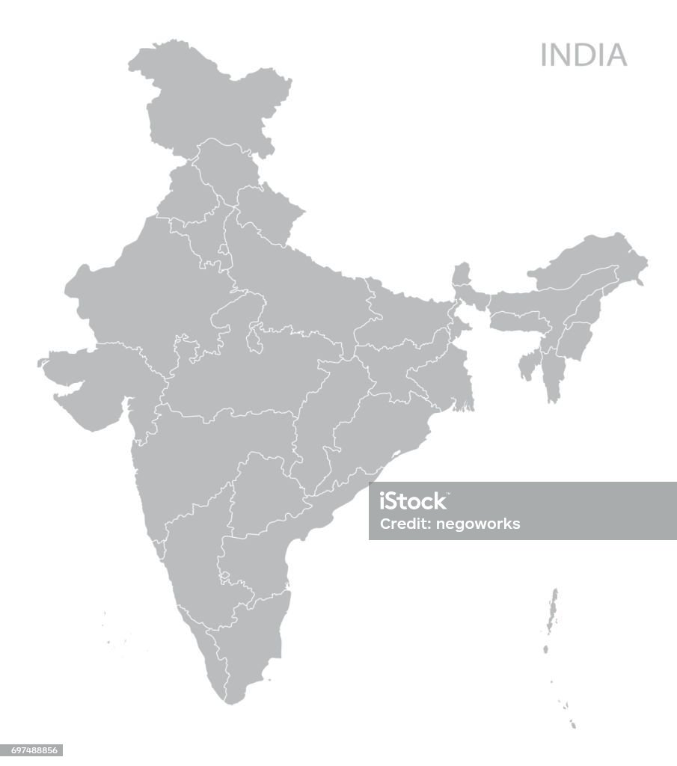
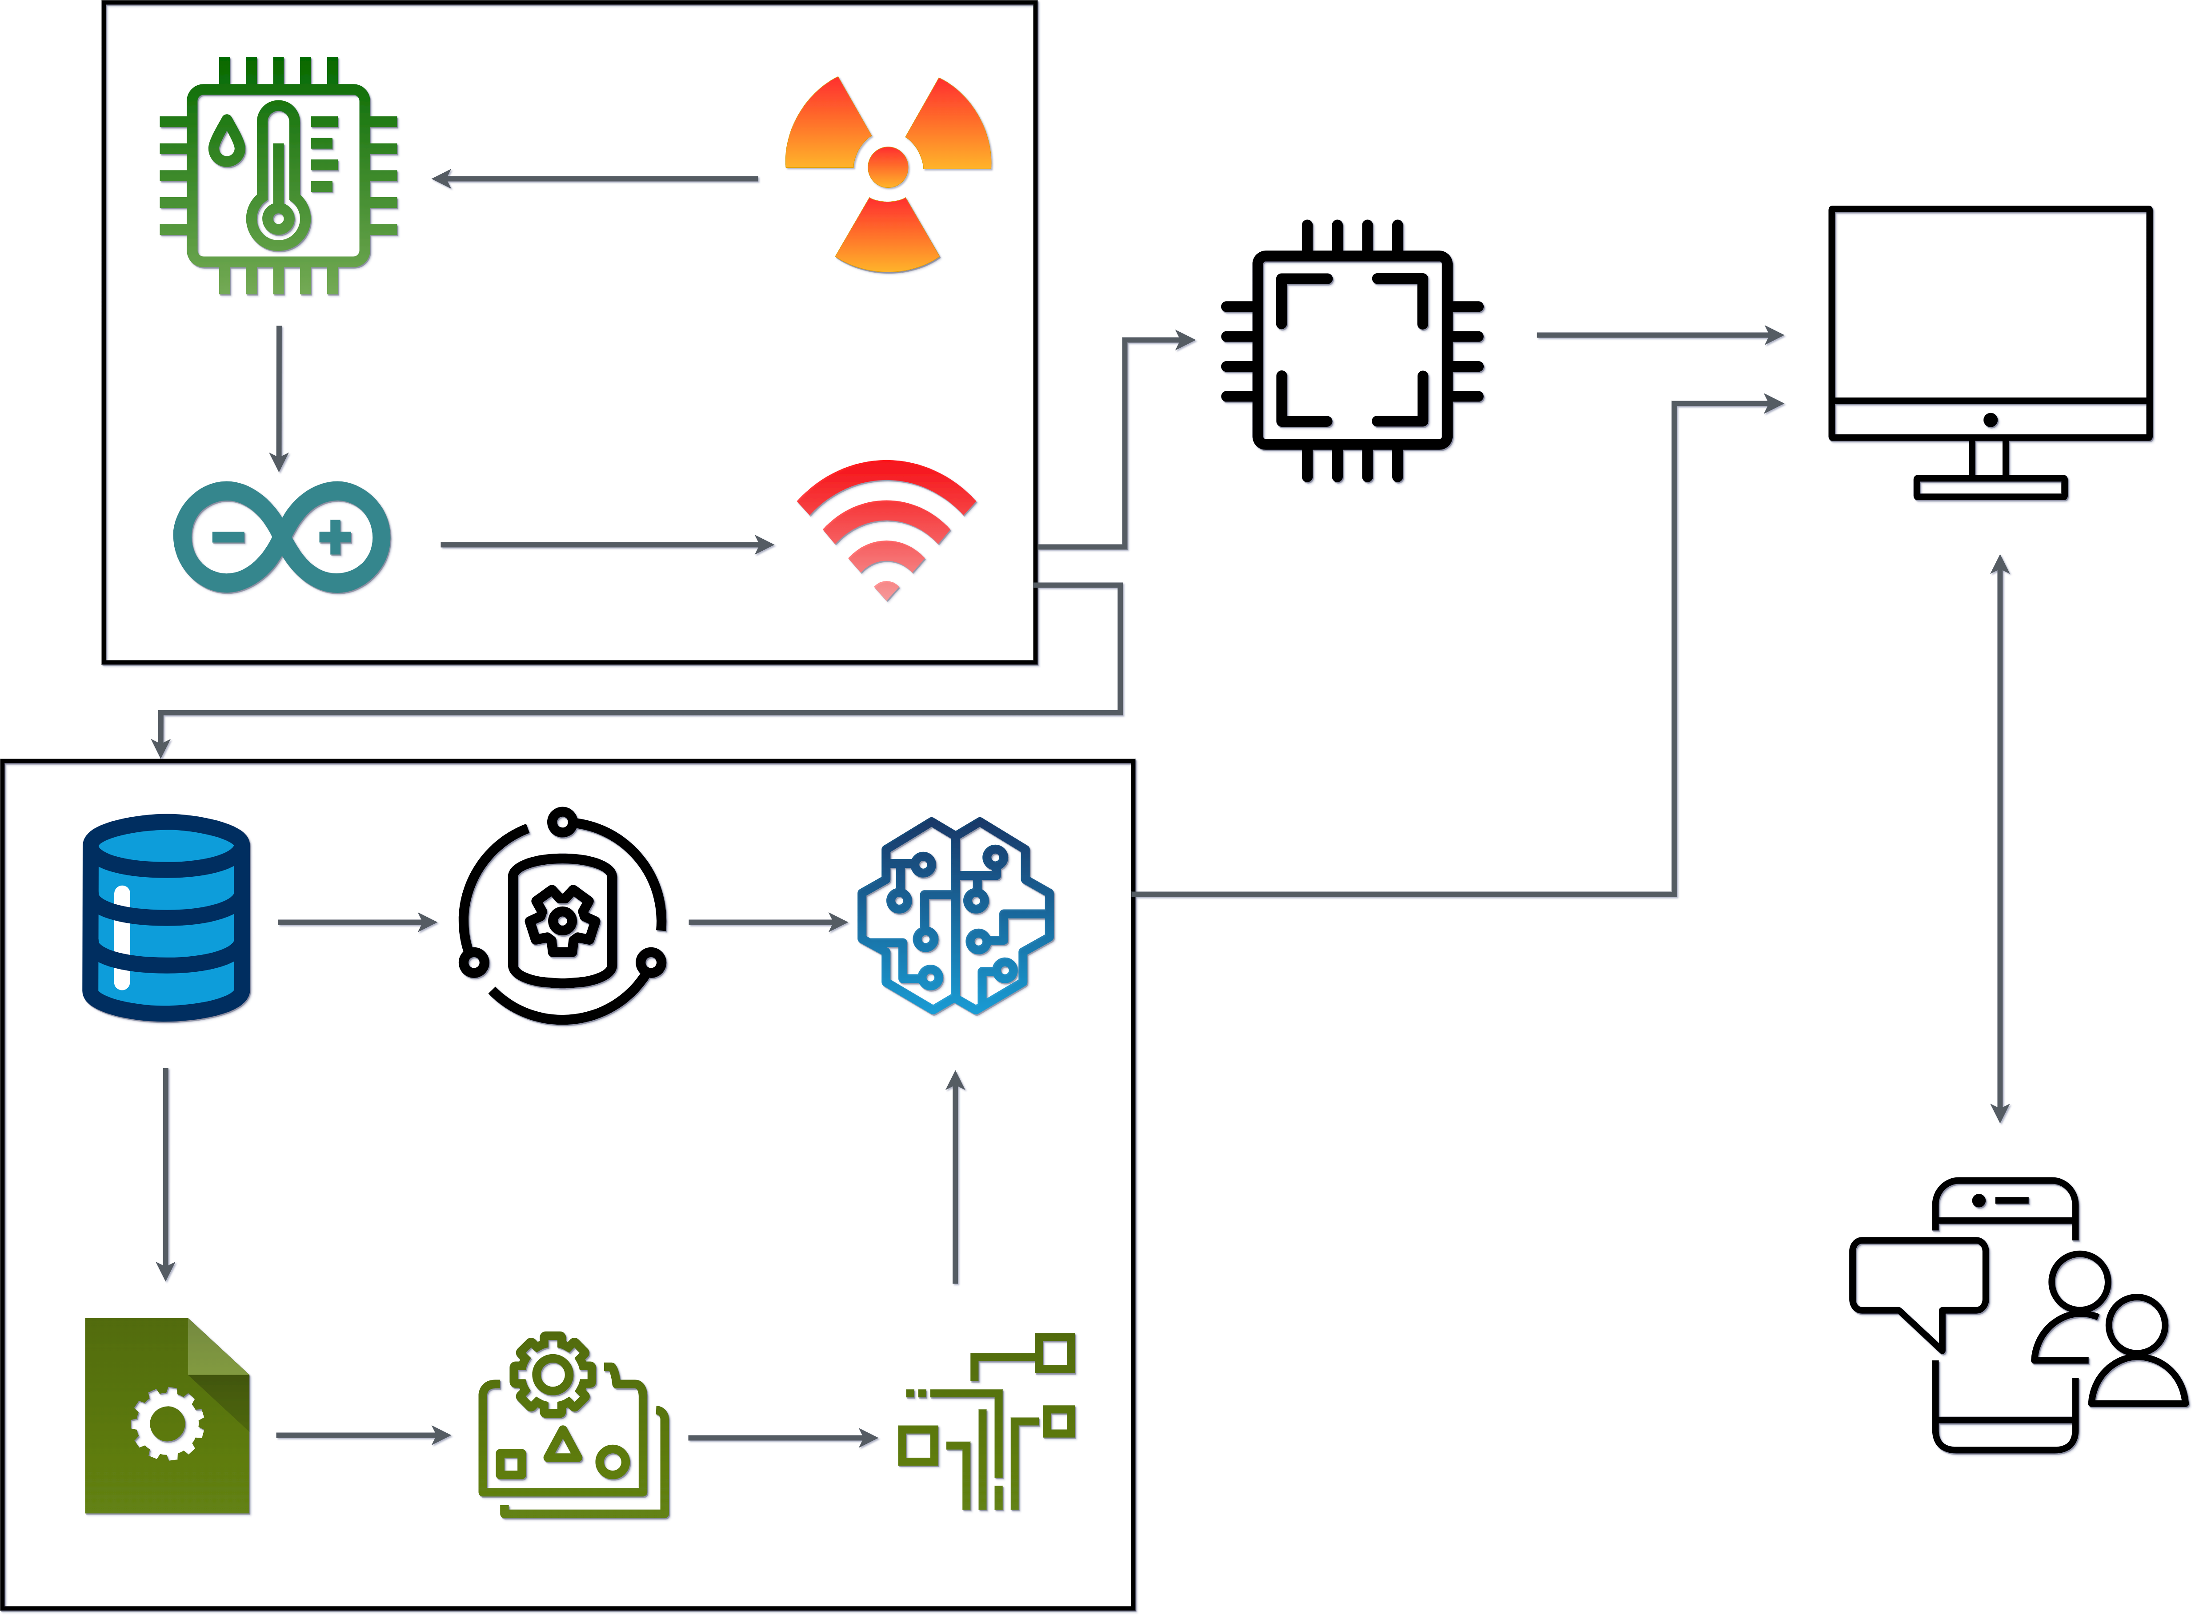


IDEA /APPROACH DETAILS
INDUSTRY - SPECIFIC SECTORIZATION : The software intelligently divides industries into sectors based on their unique perimeters on an interactive map.
RADIATION MAPPING : It precisely distinguishes zones affected by fire and categorizes radiation levels as Very High, High, Medium, or Low, ensuring firefighter safety.
MACHINE LEARNING MODELS : Utilized Machine Learning Models to predict the spread of radiation and blast waves.
ENVIRONMENTAL MONITORING : It tracks Temperature, Pressure, Levels of Toxic Gases, Wind Speed and Direction in real-time to provide crucial data for firefighting strategies.
By analyzing environmental data, The software guides firefighters to the most effective and safe approaches to extinguishing the fire.
Radiation
1
Signal
4
Data
Algorithm
7
3
6
Validation
2
Data Set
5
Processing
Testing
Evaluation
1
High Potential Risk Zone
TECHNOLOGY STACK :
HTML
CSS
JavaScript
GIS – Mapping Framework
Machine Learning (Python) - Predictions
PRODUCT STATUS :
80% product built completed and further build is on progress. Testing and validation process are next to be undergone.
2
Moderate Potential Risk Zone
User Friendly Interface
3
Low Potential Risk Zone
Video Link : https://youtu.be/ZYJN48eR8jU

Slide 3
IDEA /APPROACH DETAILS
USE CASES :
INDUSTRIAL SAFETY AND EMERGENCY RESPONSE : Predict the extent of hazardous zones and radiation dispersion for industrial facilities storing volatile materials, such as chemical plants, refineries, and storage tanks.
FIREFIGHTING AND FIRST RESPONDER SUPPORT : Provide real-time information to firefighters and first responders, enabling them to approach incidents safely and efficiently.
MILITARY AND DEFENSE APPLICATIONS : Support military operations by providing intelligence on the potential impact of explosions and fires in combat zones.
PUBLIC SAFETY AND CIVIL DEFENSE : Enhance public safety by providing information to local authorities and communities about the potential danger zones during incidents like terrorist attacks or large-scale accidents.
TEMPERATURE
CHANNELS : Govt.Software, Industries, Organizations etc.
DEPENDENCIES :
LEVELS :
47%
TOXIC GASES
GEOSPATIAL DATA
HAZARDOUS MATERIAL DATA
ENVIRONMENTAL FACTORS
USER TRAINING AND SKILL DEVELOPMENT
PRESSURE
34%
G-Drive Link : https://drive.google.com/drive/folders/1VIl3rktOLY7UFm3lOQcwuxk7nNZfxE59?usp=sharing
Revenue Streams : Service based model.

Slide 4
TEAM MEMBER DETAILS
Team Leader Name : Boobathi Raja K M
Branch : B.E Stream : ECE Year II
Team Member 1 Name : Dharshan S
Branch : B.E Stream : ECE Year II
Team Member 2 Name : Aadhavan G V
Branch : B.E Stream : ECE Year II
Team Member 3 Name : Brindha S
Branch : B.E Stream : ECE Year II
Team Member 4 Name : Alagu Divya Shree M
Branch : B.E Stream : ECE Year II
Team Member 5 Name : Dhivya V
Branch : B.E Stream : ECE Year II
Team Mentor 1 Name : Dr Maheswaran S
Category : Academic Expertise : Embedded Systems, IoT Domain Experience : 19 Years
Team Mentor 2 Name : Indhumathi N
Category : Academic Expertise : Embedded Systems Domain Experience : 6 Years

